Slide 1
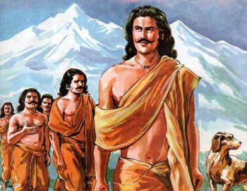
Srimad Bhagavatam
1st Canto 15th Chapter - The Pāṇḍavas Retire Timely

Slide 2
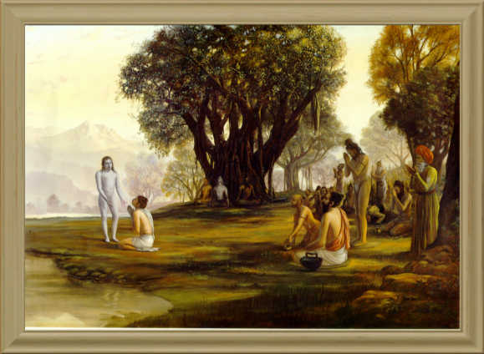
Srimad Bhagavatam
1.15.36 – 1.15.44
By Nritya Gauranga Das

Slide 3
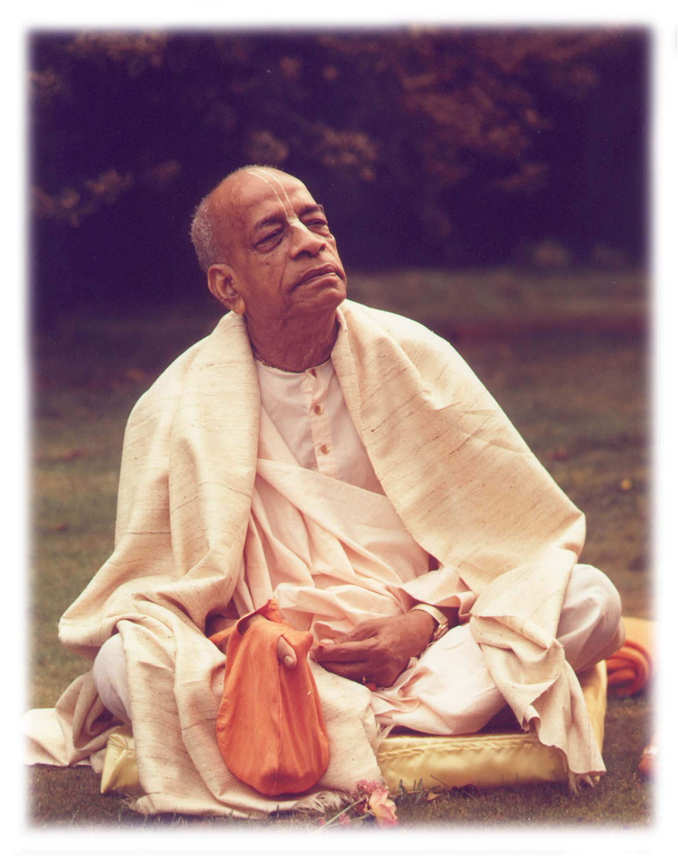
Based on the teachings of His Divine Grace A.C. Bhaktivedanta Swami Prabhupada
~ Founder Acharya ~
International Society For Krishna Consciousness

Slide 4
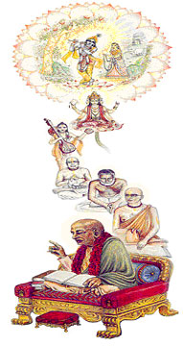
Seeking the Blessings of Guru, Gauranga & All the Assembled Vaishnavas

Slide 5
Śrīmad Bhāgavatam 1.2.4
nārāyaṇaḿ namaskṛtya
naraḿ caiva narottamam
devīḿ sarasvatīḿ vyāsaḿ
tato jayam udīrayet
TRANSLATION
Before reciting this Śrīmad-Bhāgavatam, which is the very means of conquest, one should offer respectful obeisances unto the Personality of Godhead, Nārāyaṇa, unto Nara-nārāyaṇa Ṛṣi, the supermost human being, unto mother Sarasvatī, the goddess of learning, and unto Śrīla Vyāsadeva, the author.

Slide 6
Śrīmad Bhāgavatam 1.2.18
naṣṭa-prāyeṣv abhadreṣu
nityaḿ bhāgavata-sevayā
bhagavaty uttama-śloke
bhaktir bhavati naiṣṭhikī
TRANSLATION
By regular attendance in classes on the Bhāgavatam and by rendering of service to the pure devotee, all that is troublesome to the heart is almost completely destroyed, and loving service unto the Personality of Godhead, who is praised with transcendental songs, is established as an irrevocable fact.

Slide 7
Section Theme – Duty at life’s end / Prepping Final Journey
1.15.36
Lord Krsna’s departure – Kali’s full manifestation.
1.15.37
Mahārāja Yudhiṣṭhira understanding about Kali’s influence.
1.15.38 – 1.15.39
Mahārāja Yudhiṣṭhira enthroning Parikshit & Vajra as kings of Hastinapur & Surasena respectively.
1.15.40 - 42
Mahārāja Yudhiṣṭhira’s material detachment.
1.15.43
Mahārāja Yudhiṣṭhira’s severe austerities.
1.15.44
Mahārāja Yudhiṣṭhira setting out on his final journey.

Slide 8
Śrīmad Bhāgavatam 1.15.36
yadā mukundo bhagavān imāḿ mahīḿ
jahau sva-tanvā śravaṇīya-sat-kathaḥ
tadāhar evāpratibuddha-cetasām
abhadra-hetuḥ kalir anvavartata
TRANSLATION
When the Personality of Godhead, Lord Kṛṣṇa, left this earthly planet in His selfsame form, from that very day Kali, who had already partially appeared, became fully manifest to create inauspicious conditions for those who are endowed with a poor fund of knowledge.

Slide 9
Lord’s Departure – Sun setting out of our sight.
When did the Age of Kali ensued?
Just after the Battle of Kurukṣetra
Kali’s Influence – Not until Lord Departure.
Mahārāja Yudhiṣṭhira envisioned Kalis’ influence prior to Arjuna's arrival from Dvārakā.
On whom does Kali influence?
Upon those who are not fully developed in God consciousness.
How to Neutralize the effects of Kali?
Always keep oneself fully under the supreme care of the Personality of Godhead.

Slide 10
Śrīmad Bhāgavatam 1.15.37
yudhiṣṭhiras tat parisarpaṇaḿ budhaḥ
pure ca rāṣṭre ca gṛhe tathātmani
vibhāvya lobhānṛta-jihma-hiḿsanādy-
adharma-cakraḿ gamanāya paryadhāt
TRANSLATION
Mahārāja Yudhiṣṭhira was intelligent enough to understand the influence of the age of Kali, characterized by increasing avarice, falsehood, cheating and violence throughout the capital, state, home and among individuals. So he wisely prepared himself to leave home, and he dressed accordingly.

Slide 11
Maharaj Yudhistira - Fearful of the Kali?
No, influence of Kali – Godless people
Maharaj Yudhistira – Great devotee of the Lord
Eternal Companion – More interested in the company of the Lord
Ideal King – Want to set an example.
Examples – Modern politicians & retired old gentlemen

Slide 12
Śrīmad Bhāgavatam 1.15.38
sva-rāṭ pautraḿ vinayinam
ātmanaḥ susamaḿ guṇaiḥ
toya-nīvyāḥ patiḿ bhūmer
abhyaṣiñcad gajāhvaye
TRANSLATION
Thereafter, in the capital of Hastināpura, he enthroned his grandson, who was trained and equally qualified, as the emperor and master of all land bordered by the seas

Slide 13
What’s Significance of vinayinam?
Good administration of Emperor – Joyful Citizen
Happiness – Due to production of Natural Produce
Free from 3 types of klesha’s
No resentment – But sometimes state kings fought for Political reasons & Supremacy
Every one trained to attain Highest goal of life.
If administration is good why then there was increasing avarice, falsehood, cheating and violence throughout the capital, state, home and among individuals?
Influence of the age of Kali gradually infiltrated the good qualities of both the kings and the citizens.

Slide 14
Śrīmad Bhāgavatam 1.15.39
mathurāyāḿ tathā vajraḿ
śūrasena-patiḿ tataḥ
prājāpatyāḿ nirūpyeṣṭim
agnīn apibad īśvaraḥ
TRANSLATION
Then he posted Vajra, the son of Aniruddha [grandson of Lord Kṛṣṇa], at Mathurā as the King of Śūrasena. Afterwards Mahārāja Yudhiṣṭhira performed a Prājāpatya sacrifice and placed in himself the fire for quitting household life.

Slide 15
Varnasrama dharma :
Varnas - Divisions of Occupations (4)
Ashramas - Orders of life (4)
Yudhiṣṭhira Maharaj Vs Modern politicians
How to arrange our life?
Last 15 to 20 year – Absolutely devoted to Devotional Service.
Mind absorbed in fruitive work - No chance of getting out from conditioned life.
What is suicidal policy?
Neglecting one's supreme task of attaining the highest perfection of life.

Slide 16
Śrīmad Bhāgavatam 1.15.40
visṛjya tatra tat sarvaḿ
dukūla-valayādikam
nirmamo nirahańkāraḥ
sañchinnāśeṣa-bandhanaḥ
TRANSLATION
Mahārāja Yudhiṣṭhira at once relinquished all his garments, belt and ornaments of the royal order and became completely disinterested and unattached to everything

Slide 17
Qualification to associate with Lord?
Purified of Material contamination.
How did Yudhistir Maharaj become “Purified”?
Gave up his royal opulence, relinquishing his royal dress and garments
Took up kaṣāya, or saffron loincloth of a sannyāsī,
Kaṣāya – Indicates freedom from all attractive material garments
Disinterested in Kingdom & Family
Attachment to Designations - Material impurity

Slide 18
Śrīmad Bhāgavatam 1.15.41
vācaḿ juhāva manasi
tat prāṇa itare ca tam
mṛtyāv apānaḿ sotsargaḿ
taḿ pañcatve hy ajohavīt
TRANSLATION
Then he amalgamated all the sense organs into the mind, then the mind into life, life into breathing, his total existence into the embodiment of the five elements, and his body into death. Then, as pure self, he became free from the material conception of life.

Slide 19
How to become free by Yogic Process?
Yoga System – Relinquish this body, according to one’s own desire.
Ex: Bhishmadev
Rajarsi - Kings who are as good as rsis – Not a Political Opportunist.
Die to Live

Slide 20
Why this yoga system impractical in Kali yuga?
No proper training is available.
No practice of Brahmacarya.
Practical Application for the Age of Kali
BG 15.7 – Mamai Vamso Jiva Loke…
Remedy – First control the mind & then the Senses. How?
Bhakti-yoga system - Engage the senses and the mind in Krsna's service
Ex Ambarish Maharaj - Sa vai manah krsna-padaravindayoh…
At the time of death Lord Krsna will help us. How?
SB 1.2.17 - srnvatam sva-kathah krsnah…
BG 8.5 - anta-kāle ca mām eva…
BG 10.10] - tesam satata-yuktanam…

Slide 21
Śrīmad Bhāgavatam 1.15.42
tritve hutvā ca pañcatvaḿ
tac caikatve 'juhon muniḥ
sarvam ātmany ajuhavīd
brahmaṇy ātmānam avyaye
TRANSLATION
Thus annihilating the gross body of five elements into the three qualitative modes of material nature, he merged them in one nescience and then absorbed that nescience in the self, Brahman, which is inexhaustible in all circumstances.

Slide 22
Mahat-tattva-avyakta
Source of variegate material products in this mateiral world.
Living entity - Not part of Mahat tattva.
How to become an associate of Supreme Lord?
Always think that he is different from the material energy
Qualitatively equal & Quantitatively different.
Process of ending Material existence?
Sense of freedom from material relations.
Freedom from the material encagement of the gross and subtle encirclement.
Jivan Mukta Stage.
Not just think like he’s Brahman but act like Brahman.

Slide 23
Śrīmad Bhāgavatam 1.15.43
cīra-vāsā nirāhāro
baddha-vāń mukta-mūrdhajaḥ
darśayann ātmano rūpaḿ
jaḍonmatta-piśācavat
anavekṣamāṇo niragād
aśṛṇvan badhiro yathā
TRANSLATION
After that, Mahārāja Yudhiṣṭhira dressed himself in torn clothing, gave up eating all solid foods, voluntarily became dumb and let his hair hang loose. All this combined to make him look like an urchin or madman with no occupation. He did not depend on his brothers for anything. And, just like a deaf man, he heard nothing.

Slide 24
Purified stage of fearlessness ?
Freed from all external affairs.
Nothing to do imperial life of family prestige.
Did not speak of material affairs.
Acted like deaf man – heard nothing.
No dependence on family members.
Complete independence from everything.
Practical Application.
Examples: Ambarish Maharaj, Prahlad Maharaj.

Slide 25
Śrīmad Bhāgavatam 1.15.44
udīcīḿ praviveśāśāḿ
gata-pūrvāḿ mahātmabhiḥ
hṛdi brahma paraḿ dhyāyan
nāvarteta yato gataḥ
TRANSLATION
He then started towards the north, treading the path accepted by his forefathers and great men, to devote himself completely to the thought of the Supreme Personality of Godhead. And he lived in that way wherever he went.

Slide 26
Mahārāja Yudhiṣṭhira followed in the footsteps of his forefathers:
Recommended path as per varṇāśrama-dharma
Do not continue family life till the end -
At certain age leave all family connections – for Self realization.
Lords Instruction:
BG 18.62 - become devotee at least at the last stage.
What does brahma param indicate?
Lord Śrī Kṛṣṇa - BG (10.13)
Practical Application:
Follow in the footsteps of our previous acharya – our spiritual masters and Srila Prabhuada.

Slide 27
References
http://www.prabhupadavani.org
http://www.romapadaswami.com
http://www.iskcondesiretree.net

Slide 28
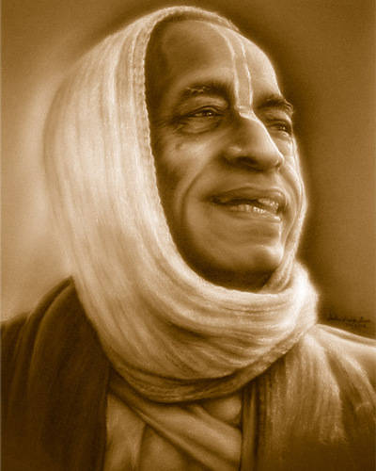
All glories to Srila Prabhupada!

